Slide 1

Trinity Rewards Viva
By Ehsan Riaz

Slide 2

Problems Addressed
I aimed to address the lack of user engagement in the University cafeteria. Cafeterias often struggle with long lines, confusing menus, and inefficient order systems. Customers sometimes face difficulty finding information about the menu, nutritional values, or deals. This results in delays, dissatisfaction, and missed opportunities for the cafeteria to improve customer experience and increase revenue.

Slide 3
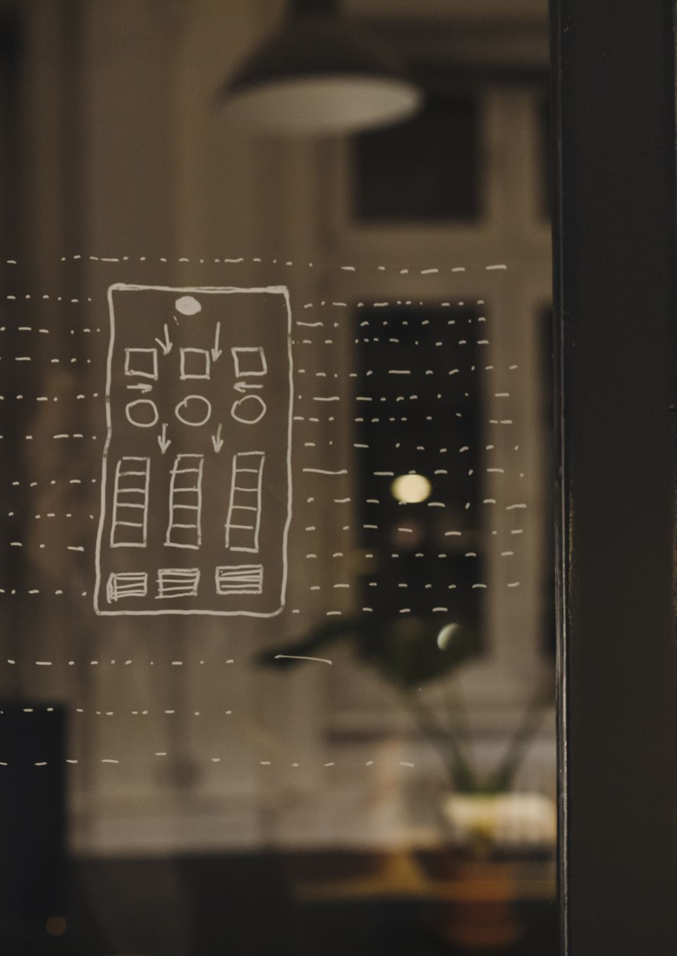
Approach Taken
To tackle this problem, I developed a food app designed for the university cafeterias. The app allows users to view the daily menu and place orders.
. The key features of the app include:
Menu Display:
Order Placement:
Points Integration:

Slide 4
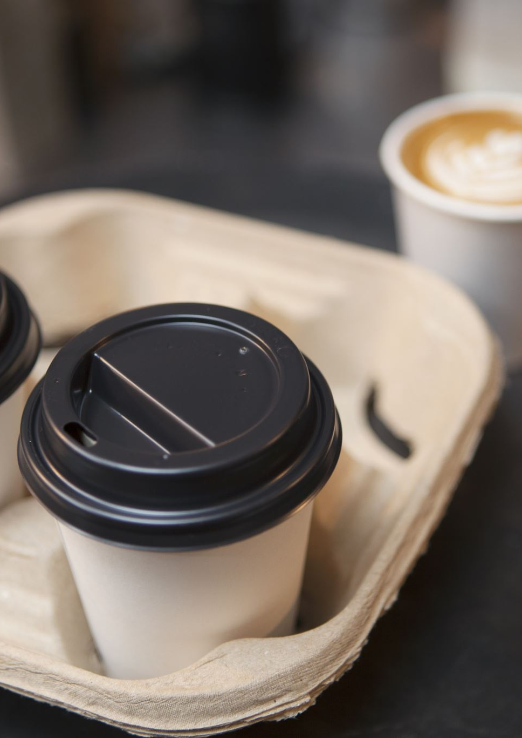
Evidence Of Success
Efficiency Improvement: The app improved order taking, reducing wait times for users by allowing them to pre-order before arriving at the cafeteria.
User Engagement: The app includes personalised features, such as favourite items, which increase user retention.
Positive Feedback: Initial testing with a small group of users showed an increase in customer satisfaction.

Slide 5
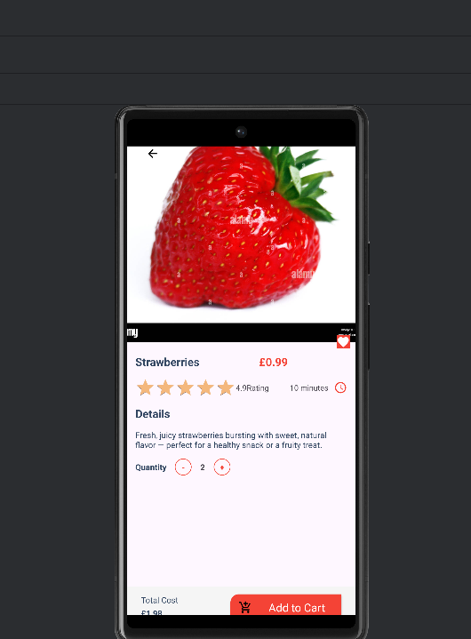
Screenshots:
Photos with Key information

Slide 6
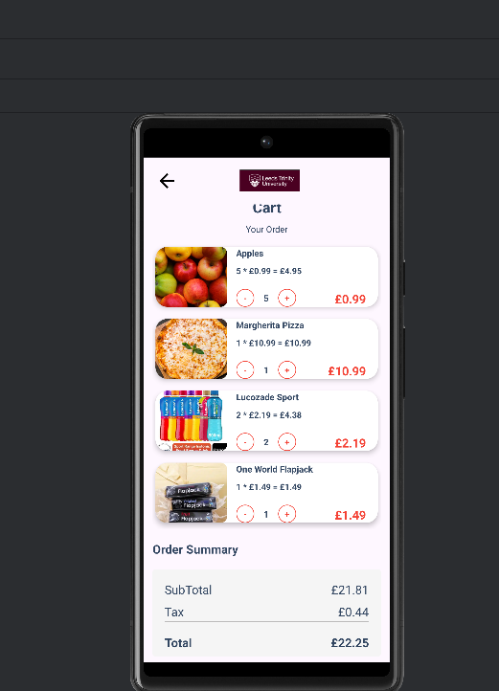
Checkout

Slide 7
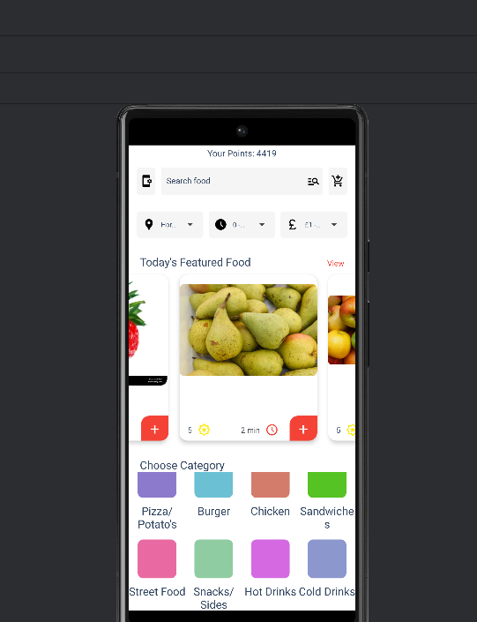
Featured Food

Slide 8

Good Points:
Good Points:
User-Friendly Interface: The design is simple, clean, and easy to navigate, making it easy to navigate even for first-time users.
Efficiency Gains: The app will reduce wait times and improve the ordering experience by eliminating the need to stand in long lines.

Slide 9
Bad Points
Limited Scalability: While the app works well in two cafeterias, scaling it to multiple locations or a larger user base would require additional resources.
Lack of Personalisation: The app could benefit from advanced features such as personalised meal recommendations or loyalty programs based on user history.

Slide 10
Final Observations and Lessons Learned:
Adaptability is Key: Designing an app for an environment like a cafeteria requires constant changes to accommodate new menu items and changing schedules.
Importance of Testing: The importance of testing with real users cannot be overstated. I received valuable feedback that helped design the apps.

Slide 11

Demonstration Walkthrough

Slide 12
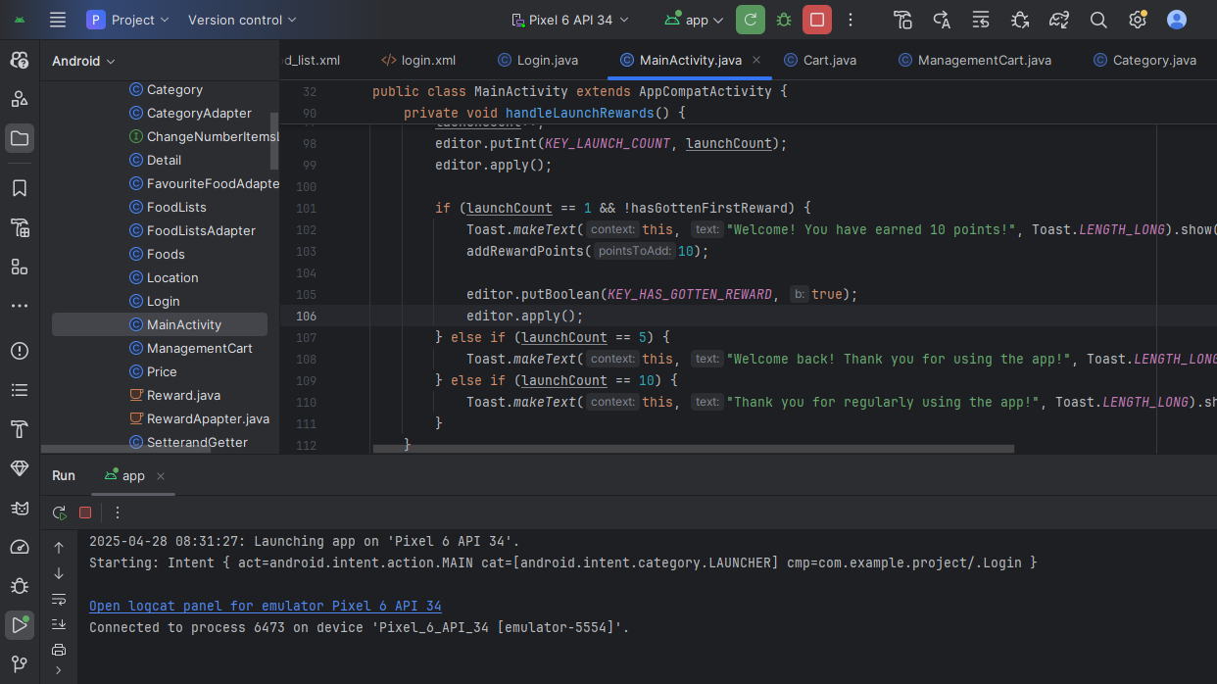
Code Snippet

Slide 13

Any Questions

